Slide 1
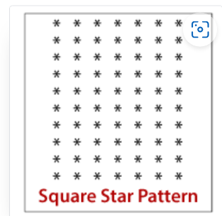
#include<stdio.h>
#include<conio.h>
int main()
{
int row,column,n;
printf("Enter number");
scanf("%d",&n);
//for(row=1;row<=n;row++)
for(row=1;row<=n;row++)
{
for(column=1;column<=n;column++)
{
printf("*");
}
//when one row is printed ,we need to add newline
printf("\n");
}
getch();
return 0;
}

Slide 2
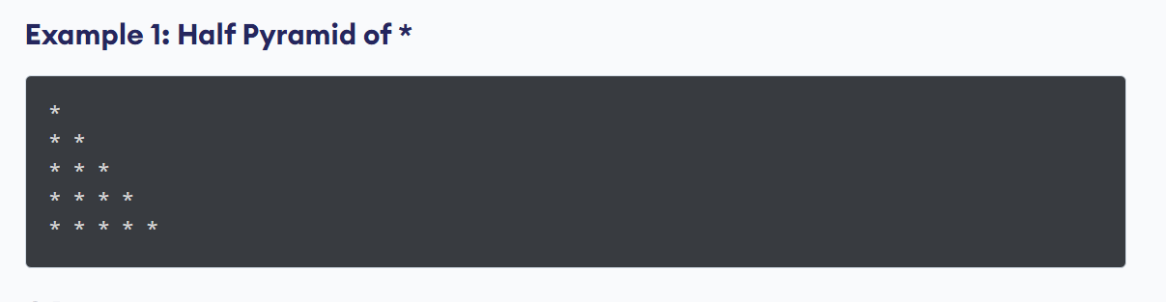
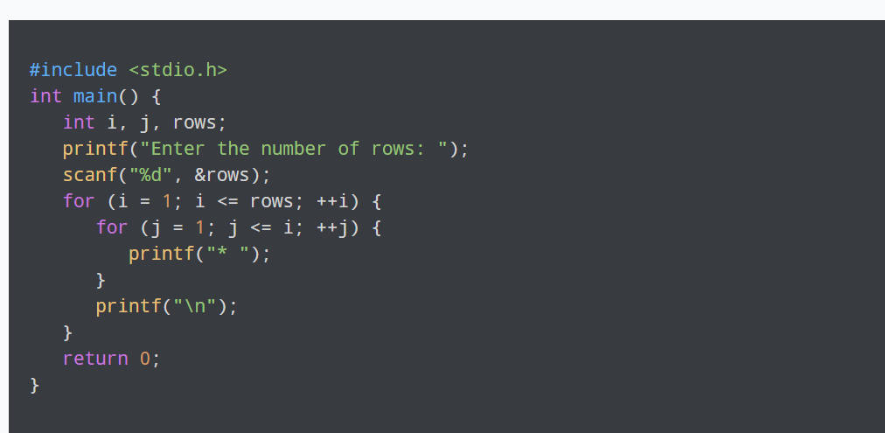

Slide 3
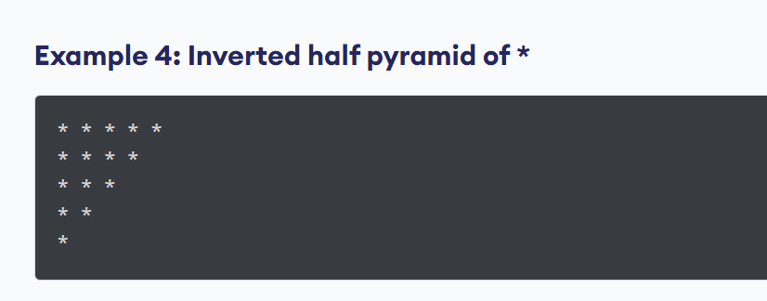
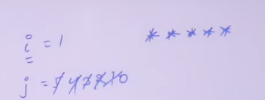
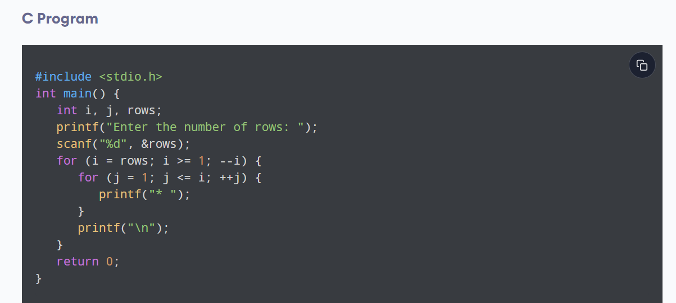
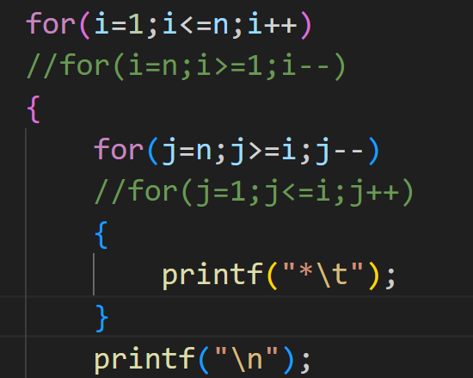

Slide 4
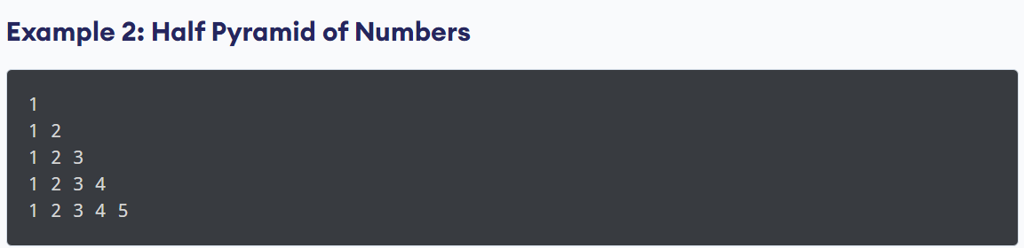
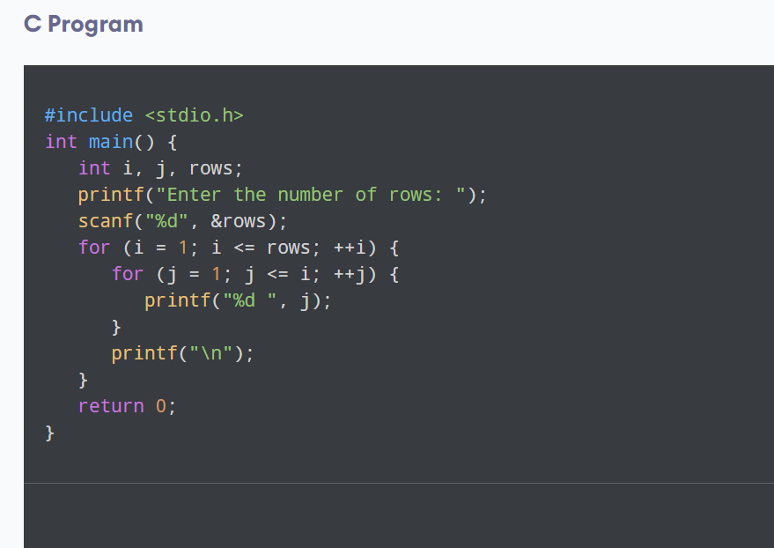

Slide 5

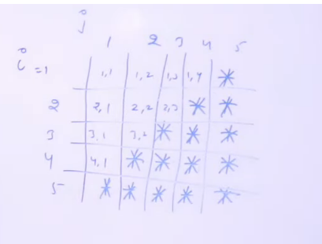
#include<stdio.h>
#include<conio.h>
int main()
{
int i,j,rows;
printf("Enter no of Rows:");
scanf("%d",&rows);
for(i=1;i<=rows;i++)
{
for(j=1;j<=rows;j++)
{
if((i+j)<=rows) //1+1<=5
printf(" ");
else
printf("*"); }
printf("\n");
}
getch(); return 0;
}

Slide 6
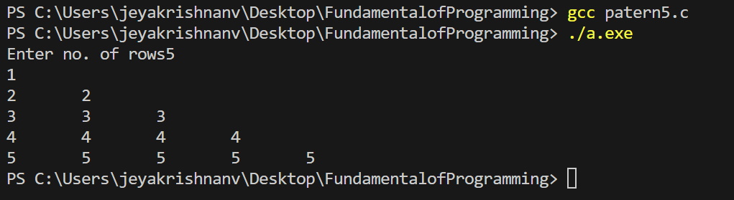
#include<stdio.h>
#include<conio.h>
void main()
{
int i,j,rows;
printf("Enter no. of rows");
scanf("%d",&rows);

Slide 7
for(i=1;i<=rows;i++)
{
for(j=1;j<=i;j++)
{
printf("%d\t",i);
}
printf("\n");
}
}

Slide 8
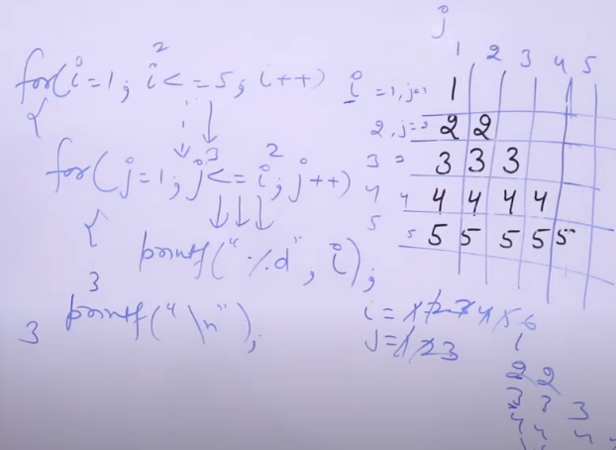

Slide 9

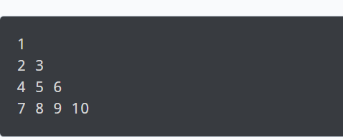
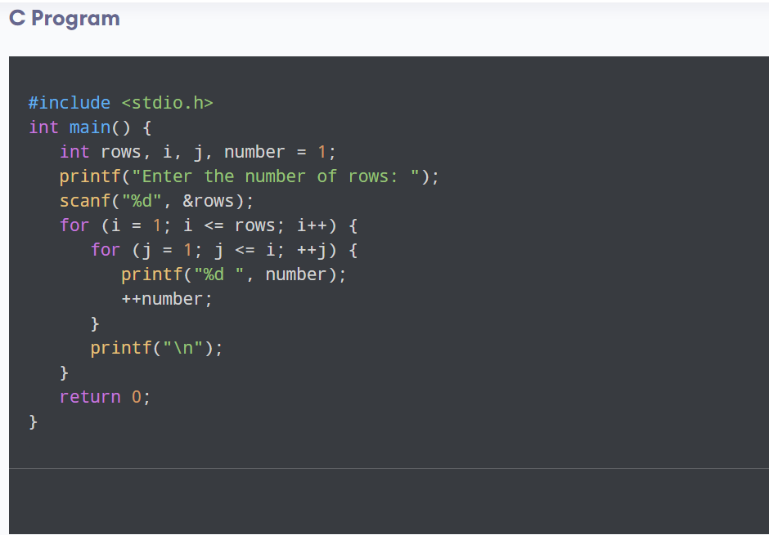

Slide 10
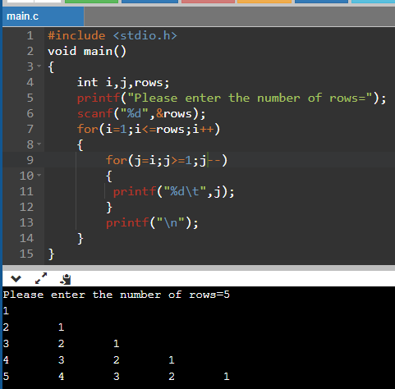
An Another Number Pattern

Slide 11
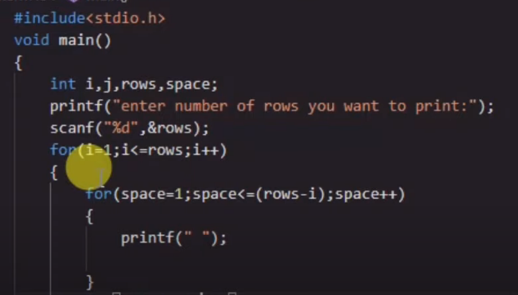

Slide 12
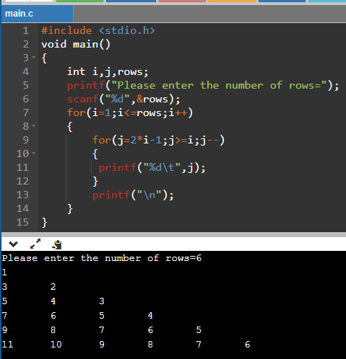
A Number Pattern

Slide 13
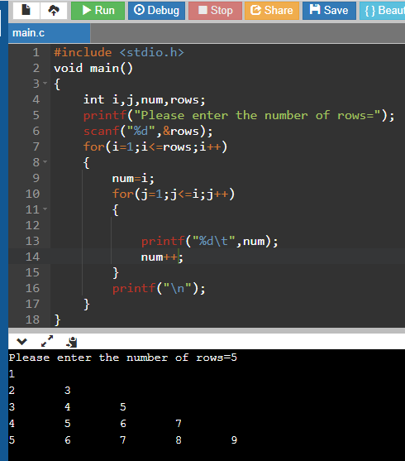
An Another Number Pattern

Slide 14
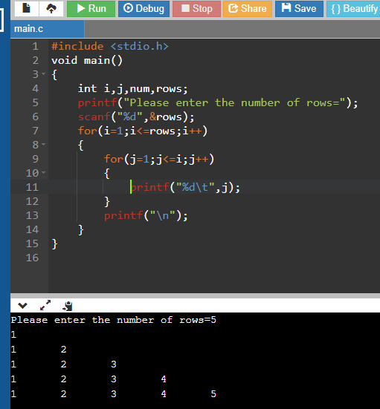
An Another Number Pattern

Slide 15
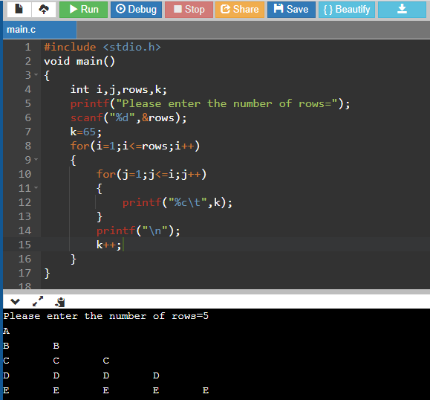
An Alphabet Number Pattern

